Slide 1

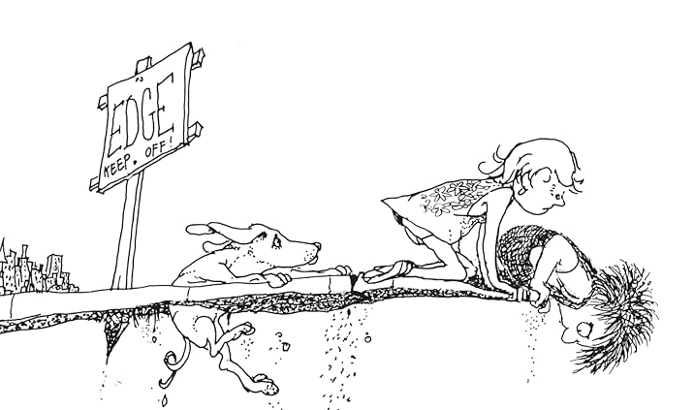



Ill.: Shel Silverstein
Where the Sidewalk Ends – Filling in the Gaps
Deanna Mills, PE – KYTC – Traffic Safety Branch
Daniel Wyatt, PE – KYTC – District 5
Jennifer Hardwick, PE, RSP1 – HMB Professional Engineers

Slide 2
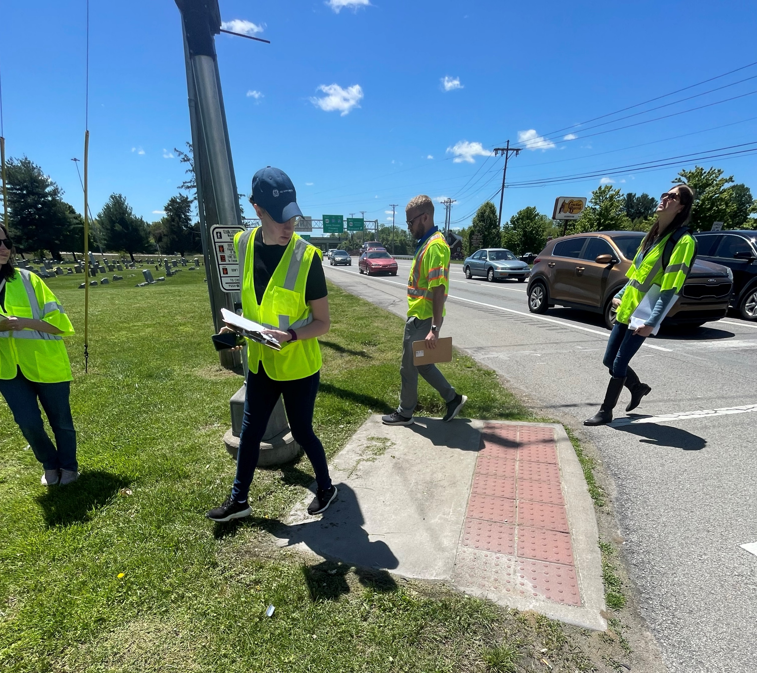
Background: VRU RSAs
Over 192 RSA locations in 2023 & 2024 – all that involve a serious injury or fatality.

Slide 3
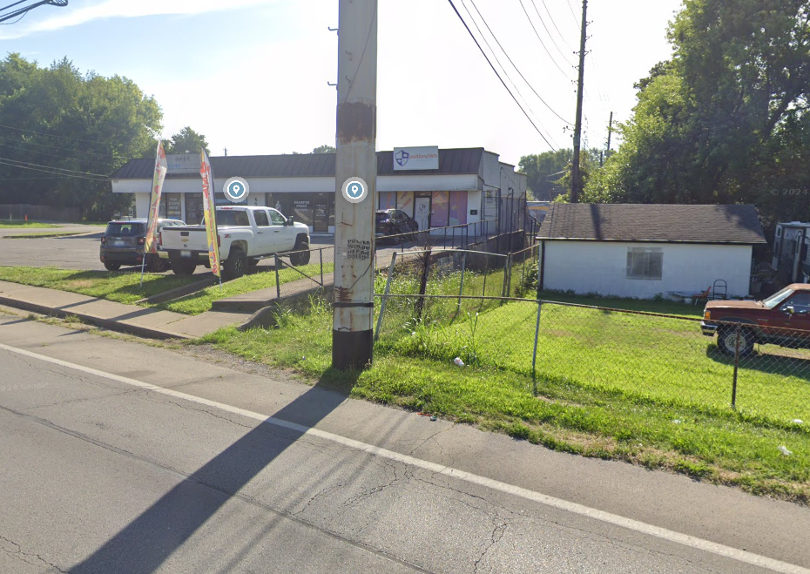


Background: Data Driven Solutions
65% of pedestrian deaths occurred in locations without a sidewalk present. – FHWA
The likelihood of a pedestrian crash along roadways with no sidewalk is 1.67 greater. – Florida DOT
Installing sidewalk has a 0.598 crash modification factor for vehicle/pedestrian collisions. CMF Clearinghouse

Slide 4
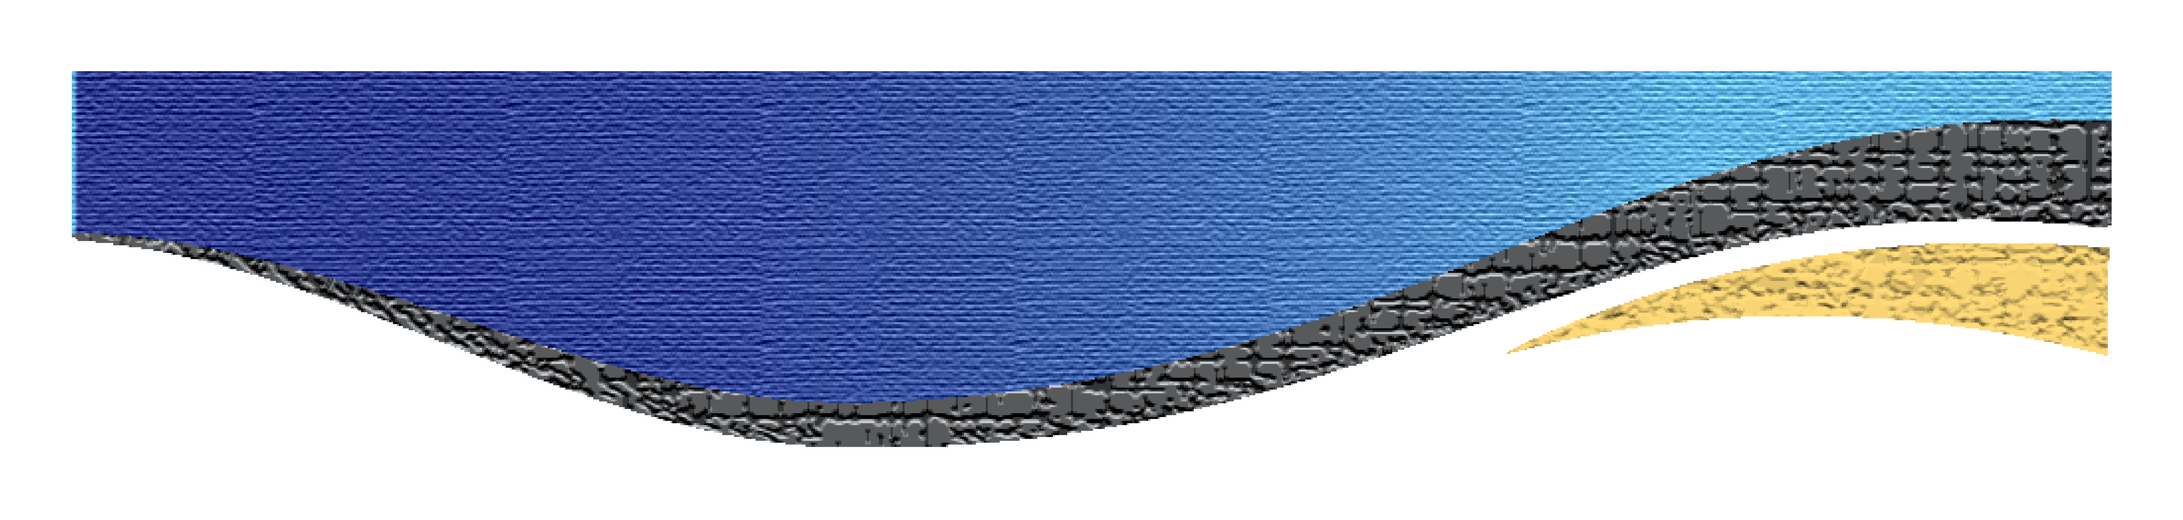
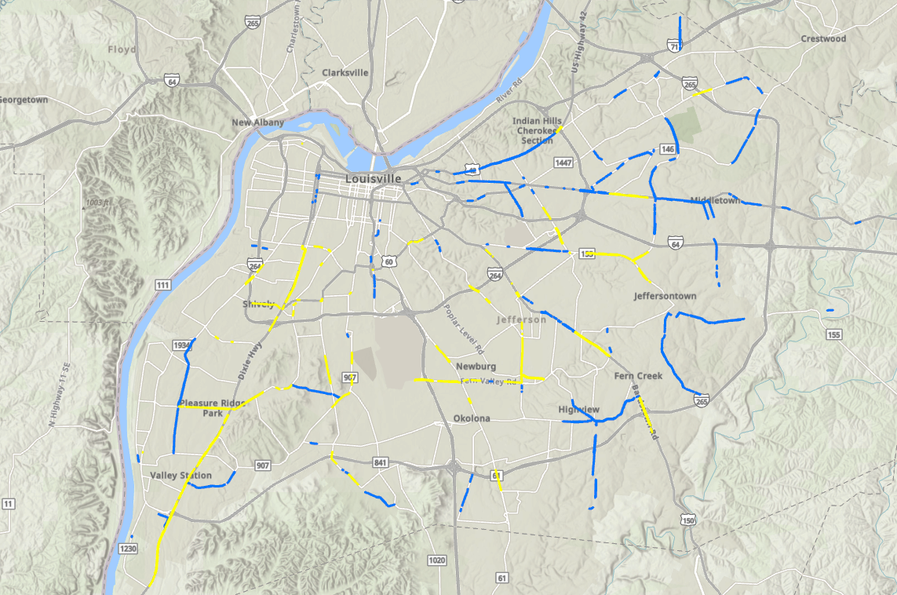
Identifying the Gaps
469 gaps identified
Over 117 miles of sidewalk
43.7% of segments were on the HIN

Slide 5
SCI Methodology: Washington D.C. Method
SCI – Sidewalk Constructability Index
  20% - Transportation Need
  20% - High Injury Network
  20% - Roadway Functional Classification
  10% - Proximity to Schools
  10% - Proximity to Parks, Trailheads, & Rec Centers
  10% - Proximity to Bus Stops
  10% - Proximity to Transit Stations
https://sidewalkgap.ddot.dc.gov/

Slide 6
SCI Methodology: Louisville Method
22.2 % - Transportation Need
  Transportation Insecurity Percentile > 66.6% = 10 Points
  Transportation Insecurity Percentile between 33.3 and 66.6% = 5 Points
  Transportation Insecurity Percentile below 33.3% = 1 Point
22.2% - High Injury Network
  On HIN = 10 Points
  Off HIN = 1 Point
22.2% - Roadway Function
  Principal Arterial = 10 Points
  Minor Arterial = 7 Points

Slide 7
SCI Methodology: Louisville Method
11.1 % - Proximity to Schools
  Less than 1/8 Mile to School = 10 Points
  Between 1/8 and 1/4 Mile = 7 Points
  Between 1/4 Mile and 1/2 Mile = 4 Points
  Over 1/2 Mile = 1 Point
11.1% - Proximity to Bus Stops
  Less than 1/8 Mile to School = 10 Points
  Between 1/8 and 1/4 Mile = 7 Points
  Between 1/4 Mile and 1/2 Mile = 4 Points
  Over 1/2 Mile = 1 Point

Slide 8
SCI Methodology – Louisville Method
11.1 % - Proximity to Shared Use Paths, Parks, and Rec Centers
  Based on the lowest distance of the 3
    Less than 1/8 Mile to School = 10 Points
    Between 1/8 and 1/4 Mile = 7 Points
    Between 1/4 Mile and 1/2 Mile = 4 Points
    Over 1/2 Mile = 1 Point

Slide 9
SCI – Top Scoring Segments

Slide 10
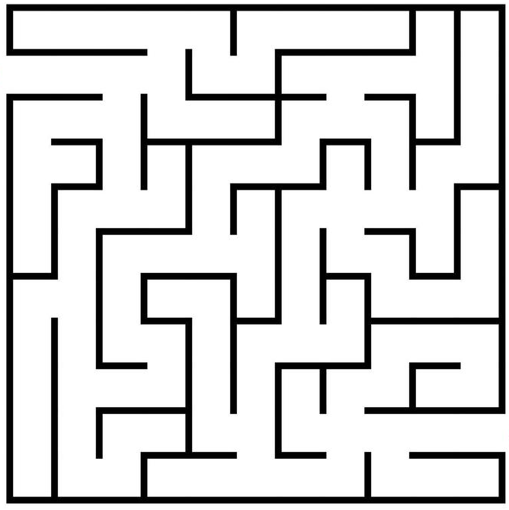
469 Identified Sidewalk Gaps
YOU ARE HERE
Constructable Projects
How do we get there from here?

Slide 11
How do we get there from here?
Step 1
Develop Strategy
Step 3
Sort Data
Step 2
Review Segments
Step 4
Select Segments

Slide 12
Step 1: Develop Strategy
Objective:
  Develop construction plans for sidewalk gaps
Information provided:
  Daniel’s list of prioritized sidewalk gaps in Jefferson County
  KMZ of sidewalk gap locations
HMB tasks:
  Perform high-level review of top 1/3 sidewalk gaps
  Assign difficulty rating to each gap
  Share results with team
Team task:
  Select group of sidewalk gaps for first round of project development

Slide 13
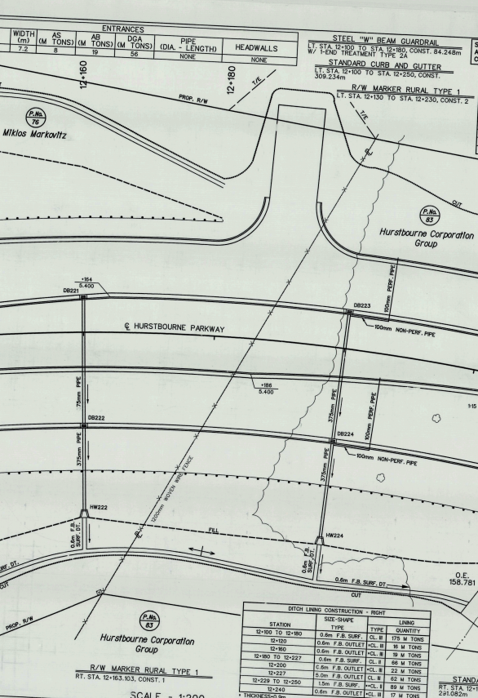
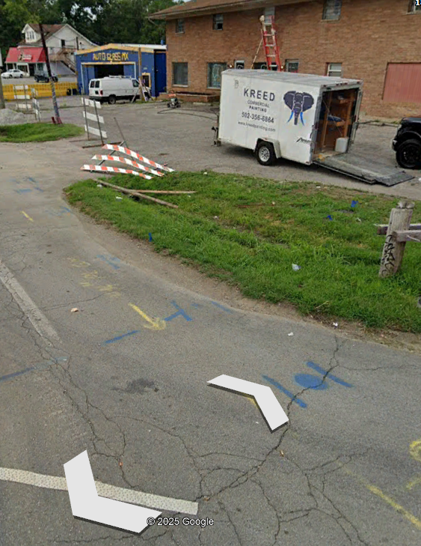

Step 2: Review Segments
High-level look at each individual sidewalk gap segment
Right-of-Way
Utilities
Construction

Slide 14
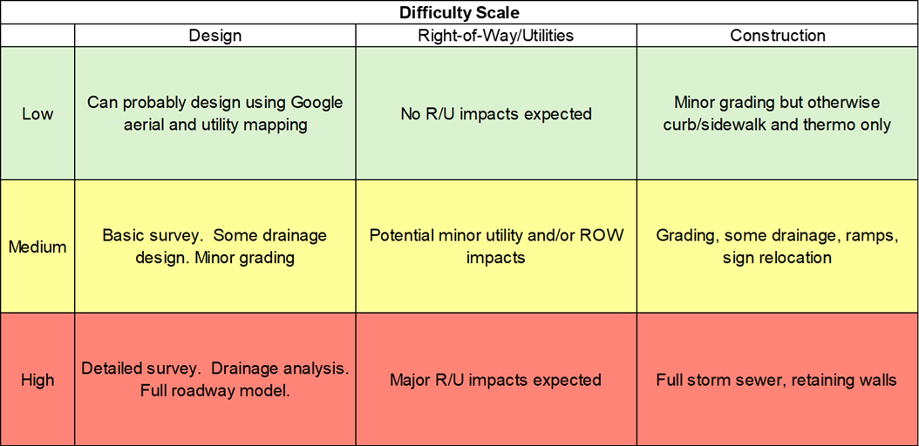
Step 3: Sort Data
Notes:
Used this high-level review to assign a difficulty rating to each segment
we wanted it to be as quantifiable and reproducible as possible – consistency throughout entire process
Developed difficulty rating system based on DRUC to provide comprehensive evaluation
Went through each segment individually and gave it a rating

Slide 15
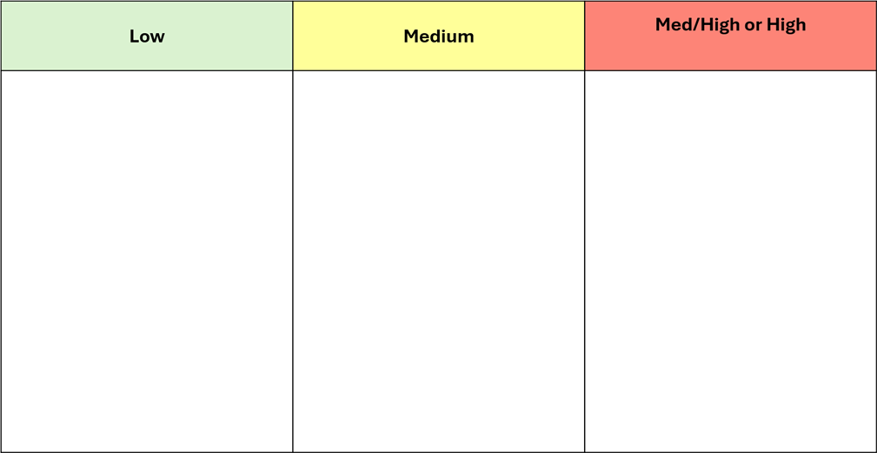
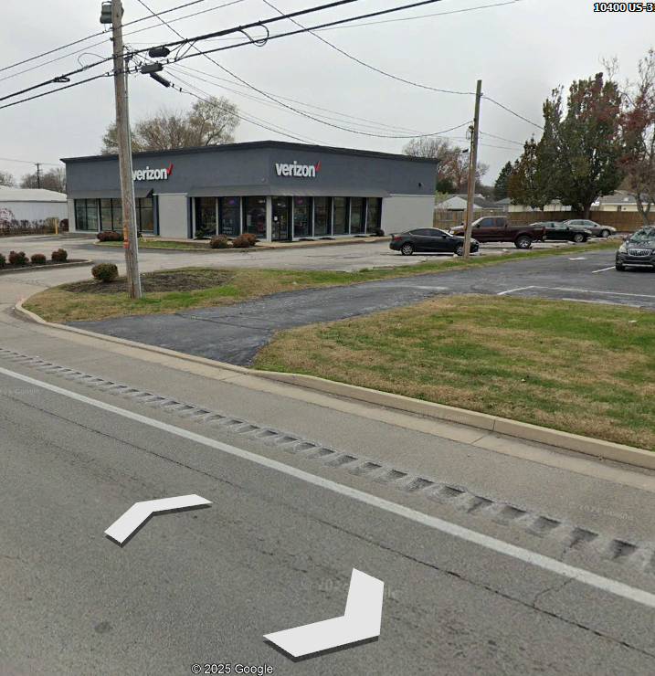
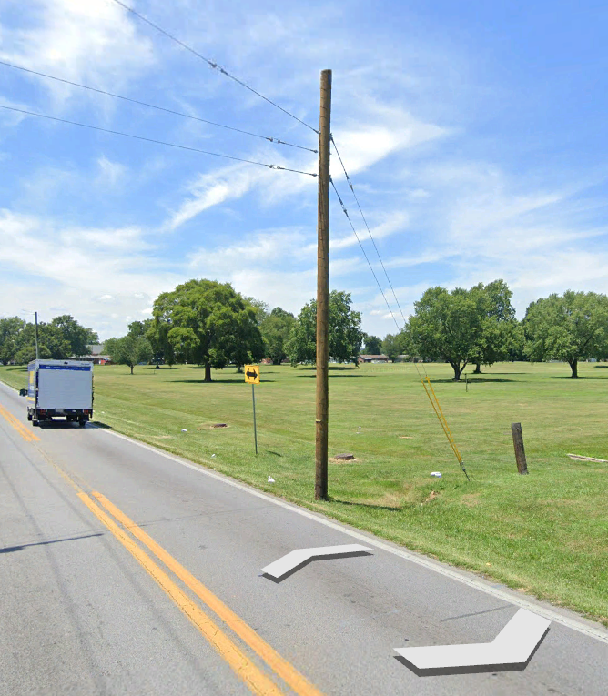
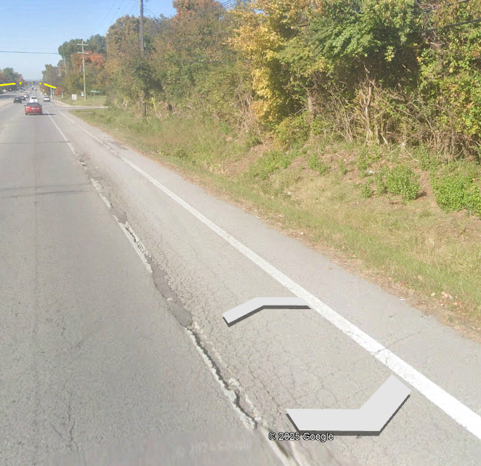
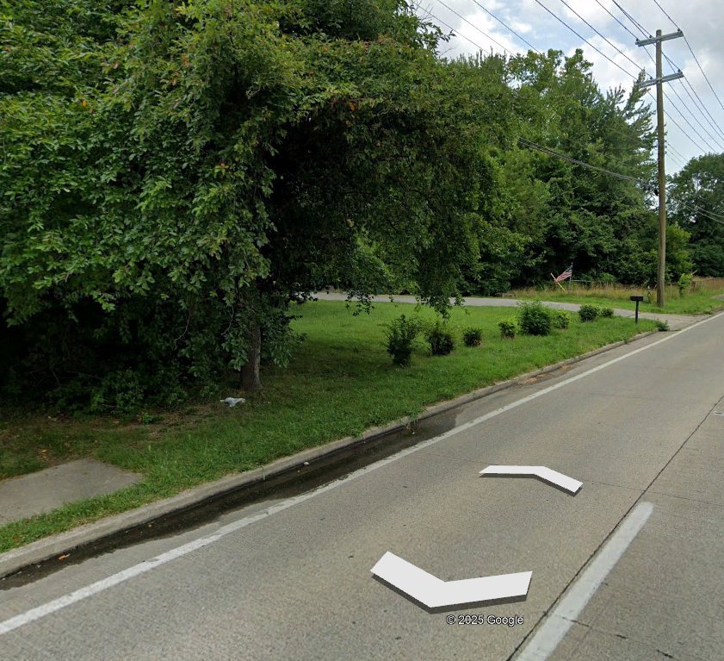
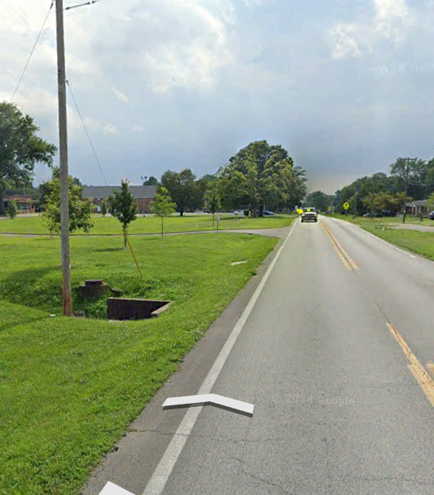
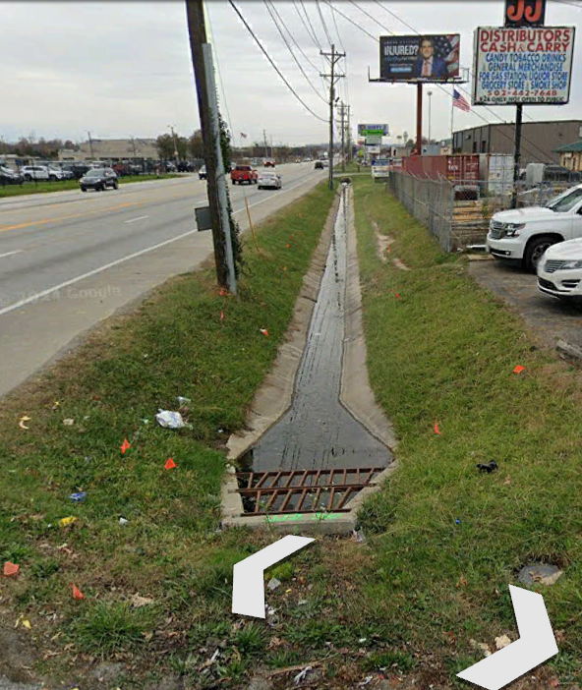
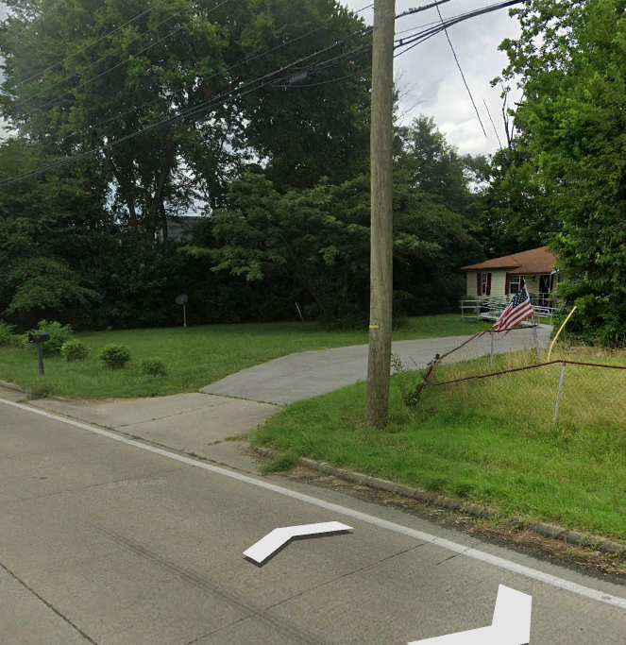
ID: |  | 348
Name: |  | KY 2052 | MP 2.8 | Right
Weighted Score: |  | 8.67
R: | Seems sufficient. May only cross a single property
U: | UP within ~6' of curb - could probably weave around. Other UG utilities unknown
C: | Already has curb and storm sewer, is just adding a short section of sidewalk
Difficulty: |  | Low
Comments: |  | Existing curb and storm sewer, flat, can likely avoid R&U impacts
Step 3: Sort Data

Slide 16
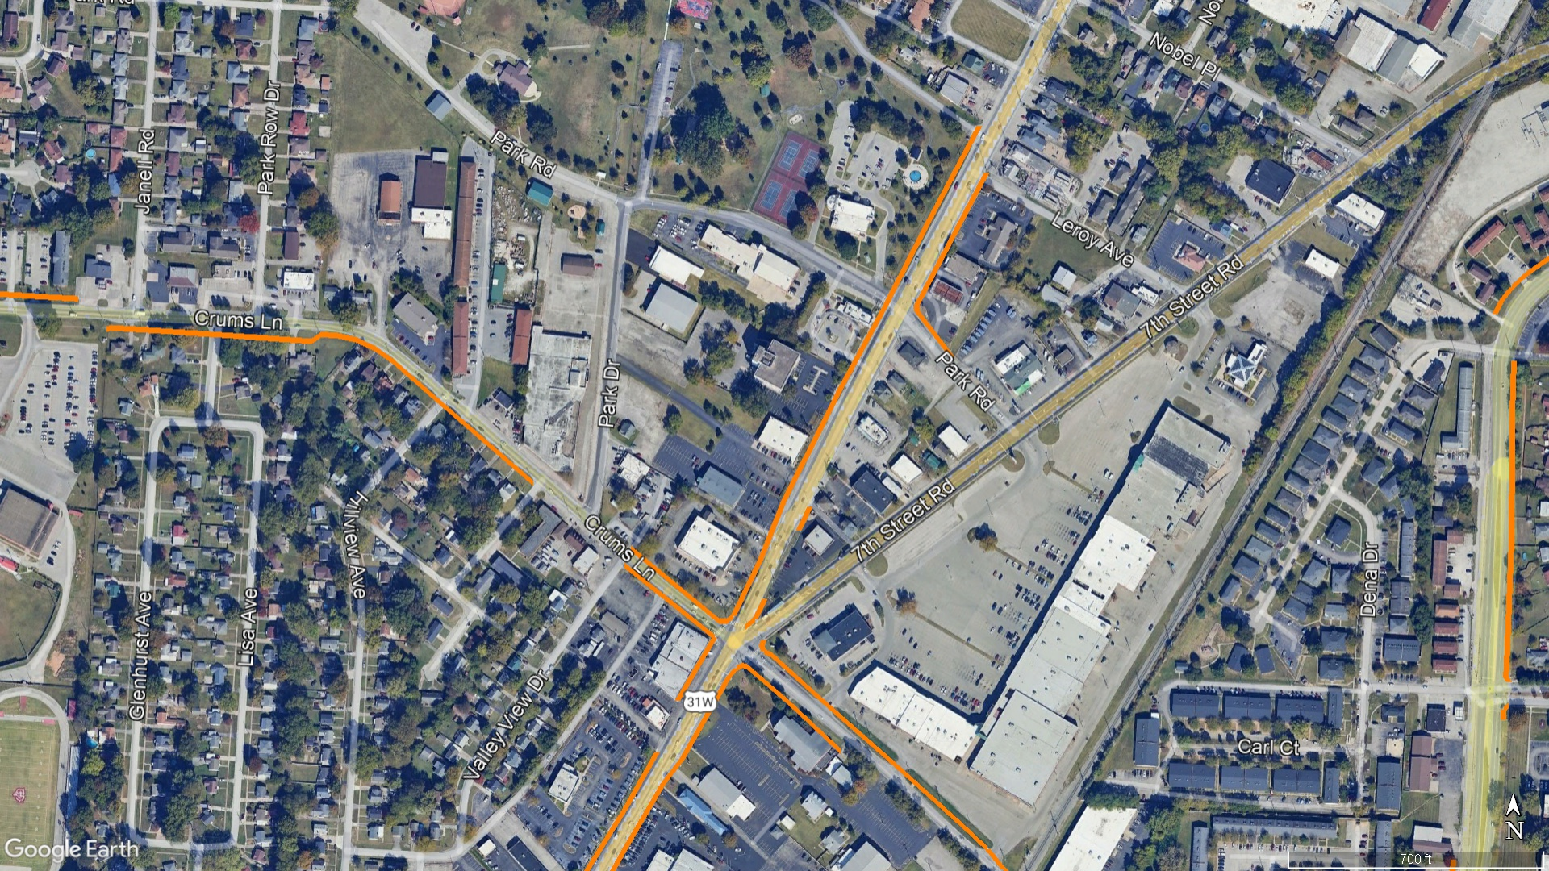
ID: |  | 348
Name: |  | KY 2052 | MP 2.8 | Right
Weighted Score: |  | 8.67
R: | Seems sufficient. May only cross a single property
U: | UP within ~6' of curb - could probably weave around. Other UG utilities unknown
C: | Already has curb and storm sewer, is just adding a short section of sidewalk
Difficulty: |  | Low
Comments: |  | Existing curb and storm sewer, flat, can likely avoid R&U impacts
Step 3: Sort Data
Existing Sidewalk

Slide 17
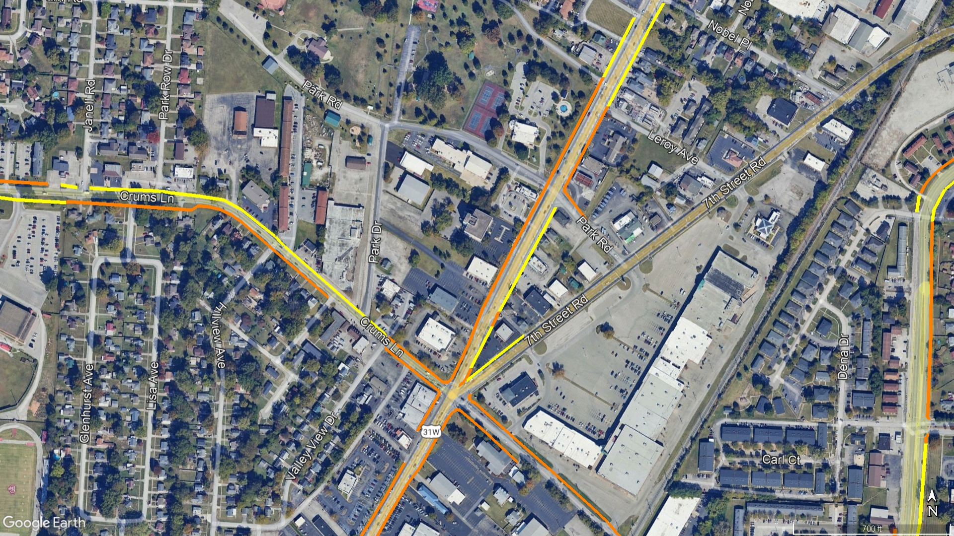
ID: |  | 348
Name: |  | KY 2052 | MP 2.8 | Right
Weighted Score: |  | 8.67
R: | Seems sufficient. May only cross a single property
U: | UP within ~6' of curb - could probably weave around. Other UG utilities unknown
C: | Already has curb and storm sewer, is just adding a short section of sidewalk
Difficulty: |  | Low
Comments: |  | Existing curb and storm sewer, flat, can likely avoid R&U impacts
Step 3: Sort Data
Existing Sidewalk
Sidewalk Gap

Slide 18
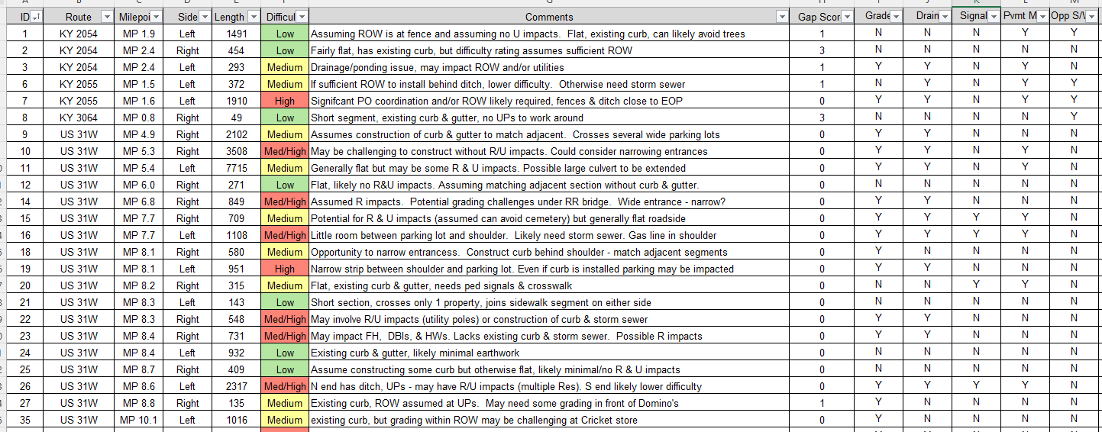
Step 3: Sort Data

Slide 19
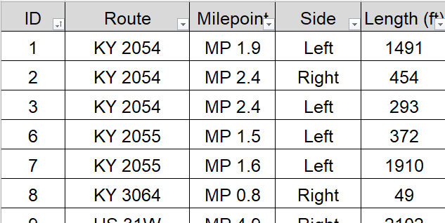
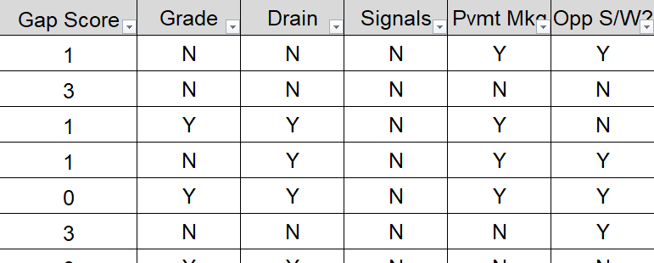
Step 3: Sort Data

Slide 20
ID: |  | 348
Name: |  | KY 2052 | MP 2.8 | Right
Weighted Score: |  | 8.67
R: | Seems sufficient. May only cross a single property
U: | UP within ~6' of curb - could probably weave around. Other UG utilities unknown
C: | Already has curb and storm sewer, is just adding a short section of sidewalk
Difficulty: |  | Low
Comments: |  | Existing curb and storm sewer, flat, can likely avoid R&U impacts
Step 4: Select Segments
Review objective:
  Develop construction plans for sidewalk gaps
Review constructability evaluation results:
  Segment evaluation spreadsheet
  Segment KMZ
Select segments for first round of development:
  US 31W from Crums Lane to Bernheim Lane
  US 31W from Bernheim Lane to Lee Street
  US 31W at Ashby Lane / Valley Station Road

Slide 21
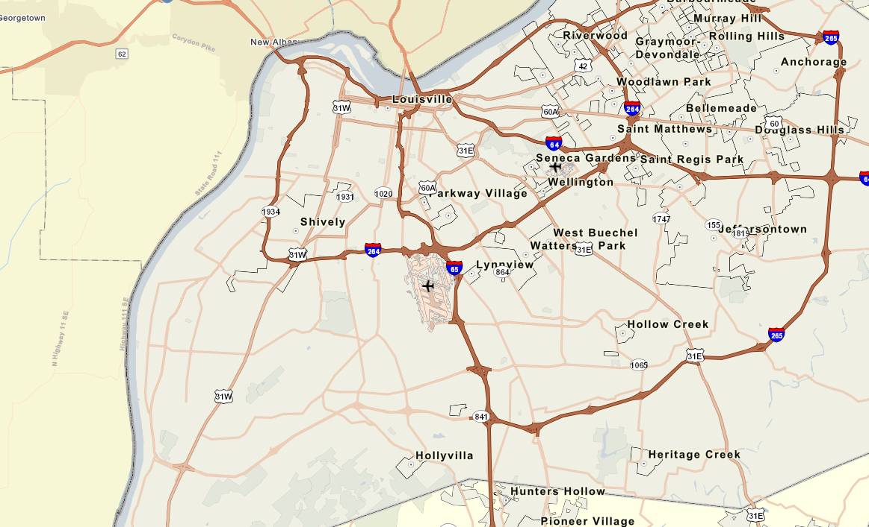
ID: |  | 348
Name: |  | KY 2052 | MP 2.8 | Right
Weighted Score: |  | 8.67
R: | Seems sufficient. May only cross a single property
U: | UP within ~6' of curb - could probably weave around. Other UG utilities unknown
C: | Already has curb and storm sewer, is just adding a short section of sidewalk
Difficulty: |  | Low
Comments: |  | Existing curb and storm sewer, flat, can likely avoid R&U impacts
Step 4: Select Segments

Slide 22

ID: |  | 348
Name: |  | KY 2052 | MP 2.8 | Right
Weighted Score: |  | 8.67
R: | Seems sufficient. May only cross a single property
U: | UP within ~6' of curb - could probably weave around. Other UG utilities unknown
C: | Already has curb and storm sewer, is just adding a short section of sidewalk
Difficulty: |  | Low
Comments: |  | Existing curb and storm sewer, flat, can likely avoid R&U impacts
Where the Sidewalk Ends – Filling in the Gaps
Daniel Wyatt, PE – KYTC – District 5
Deanna Mills, PE – KYTC – Traffic Safety Branch
Jennifer Hardwick, PE, RSP1 – HMB Professional Engineers

